Slide 1
April 6-8, 2016
Hunt Valley Inn

Slide 2
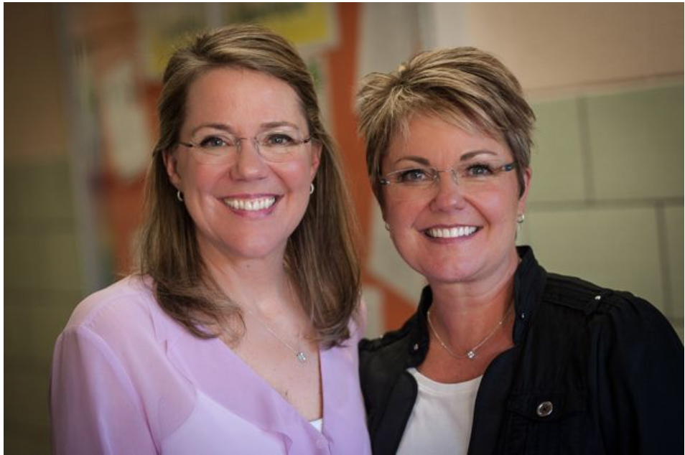
The 2 Sisters
Gail Boushey & Joan Moser

Slide 3
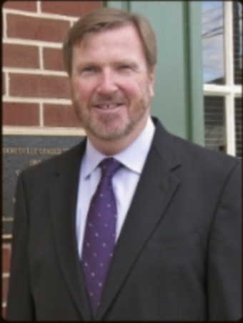
Mark Edwards, Ed.D.
Superintendent of Mooresville Graded School District
Mooresville, NC

Slide 4
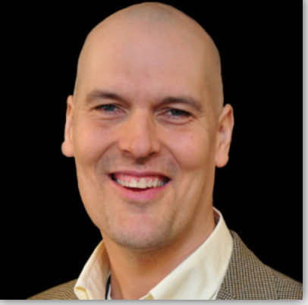
Jonathan Friesen
Author and Speaker

Slide 5
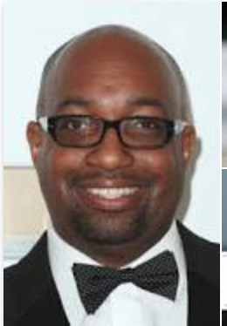
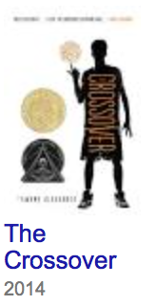
Kwame Alexander
Newbery Winner 2015

Slide 6
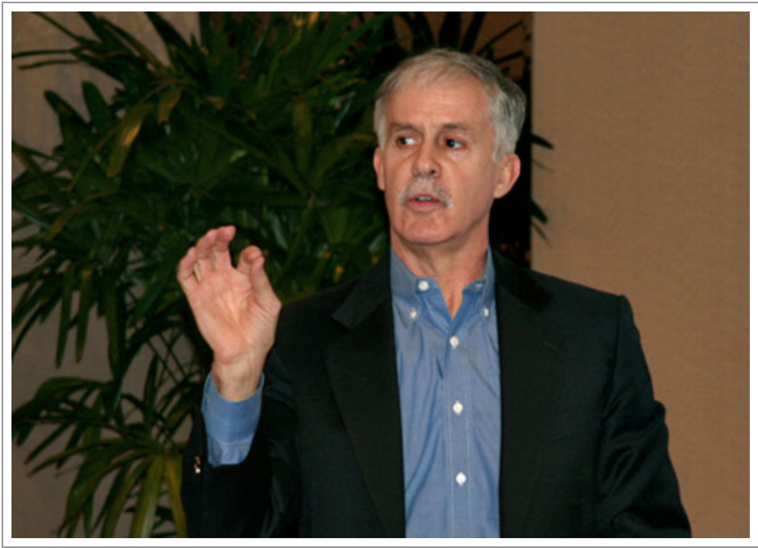
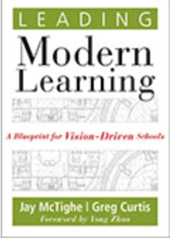
Jay McTighe

Slide 7
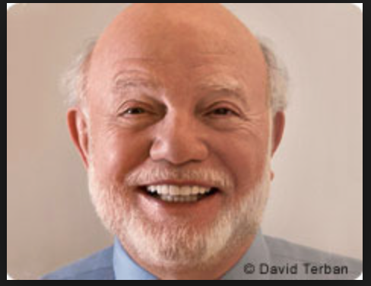
Marvin Terban

Slide 8
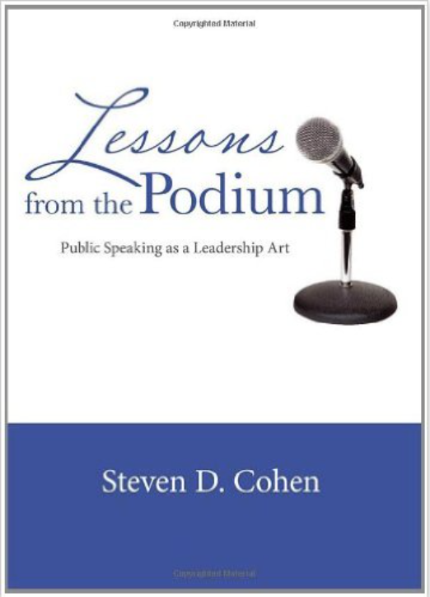
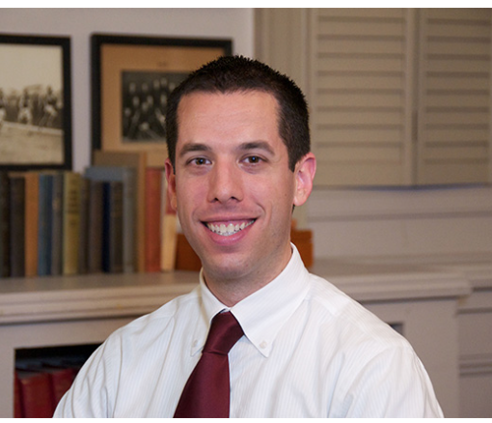
Dr. Steven D. Cohen

Slide 9
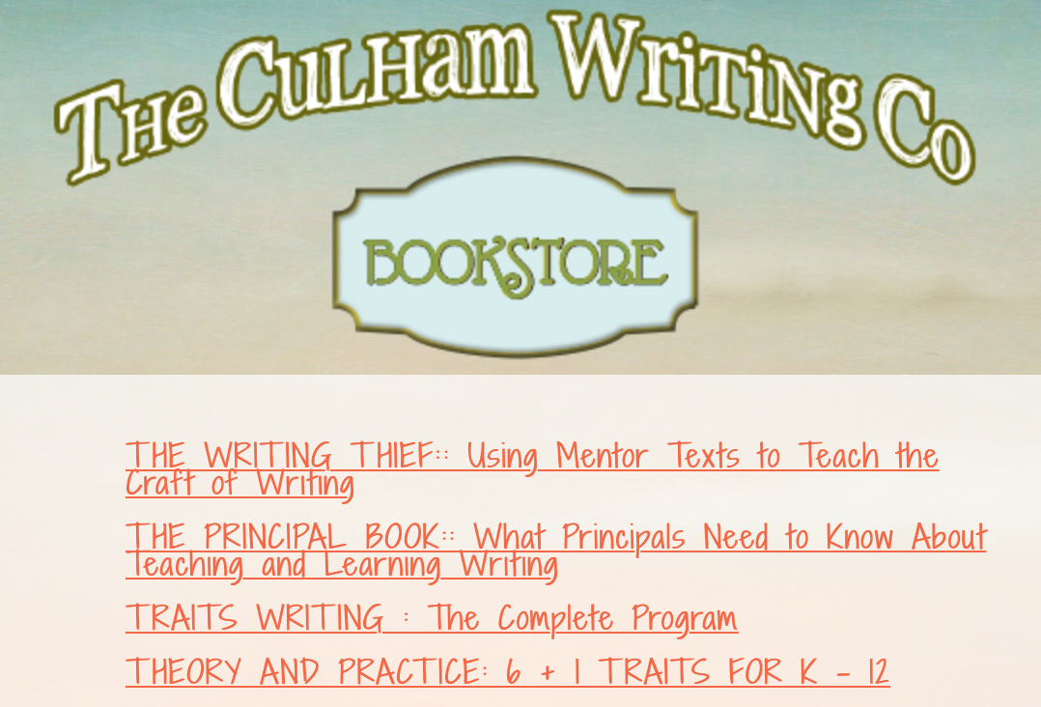
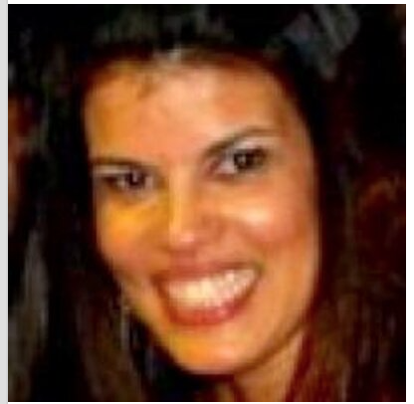
Margo Southall
Ruth Culham
Laura Robb
Amelia Van Name Larson

Slide 10
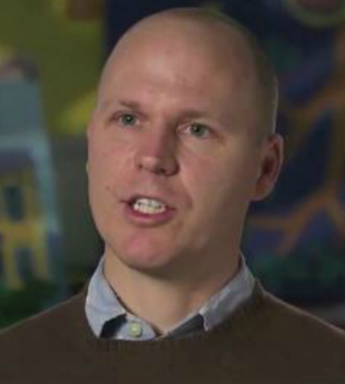
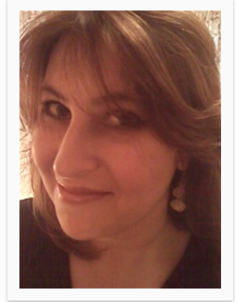
Trevor Bryan
The Art
of
Comprehension
Barbara Boroson

Slide 11
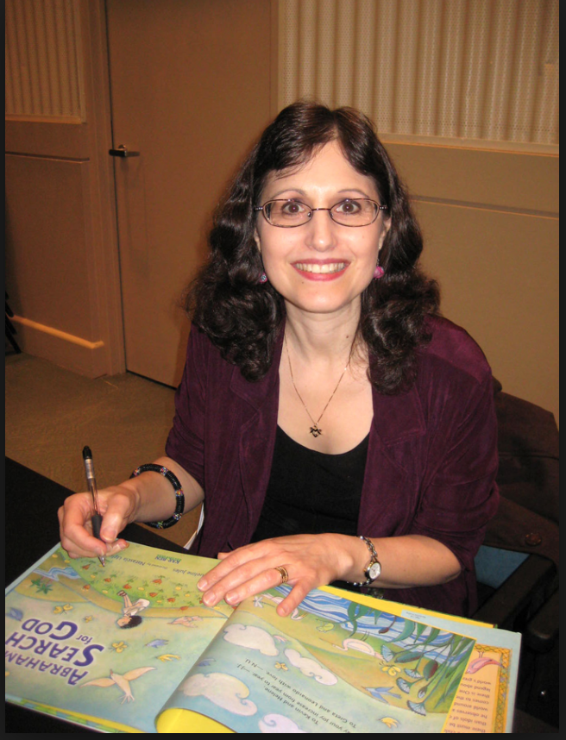
Jacqueline Jules

Slide 12
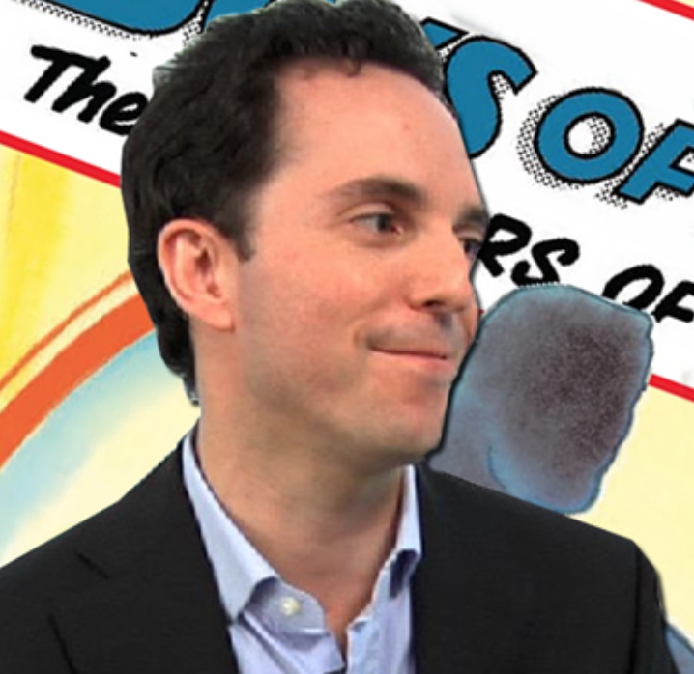
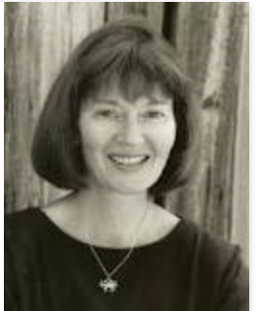
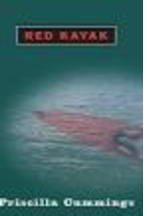
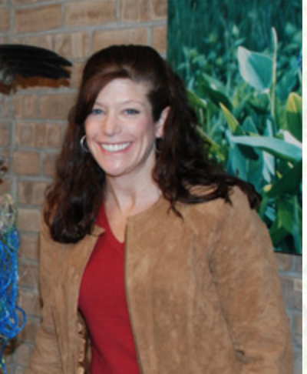
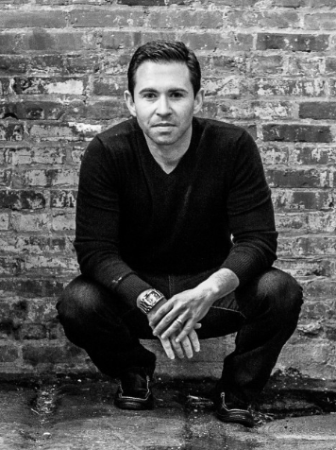
Marc Tyler Nobleman
Priscilla Cummings
Jennifer Keats Curtis
Richie Frieman

Slide 13
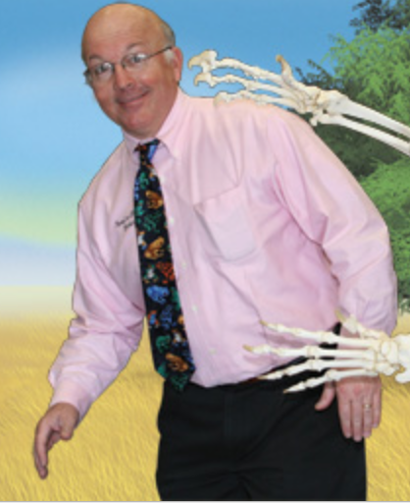
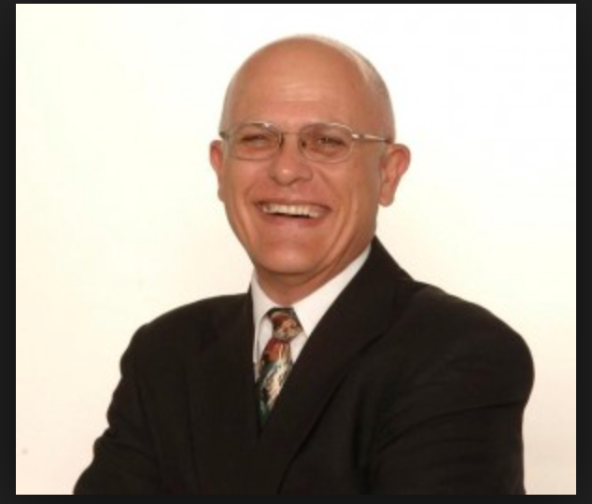
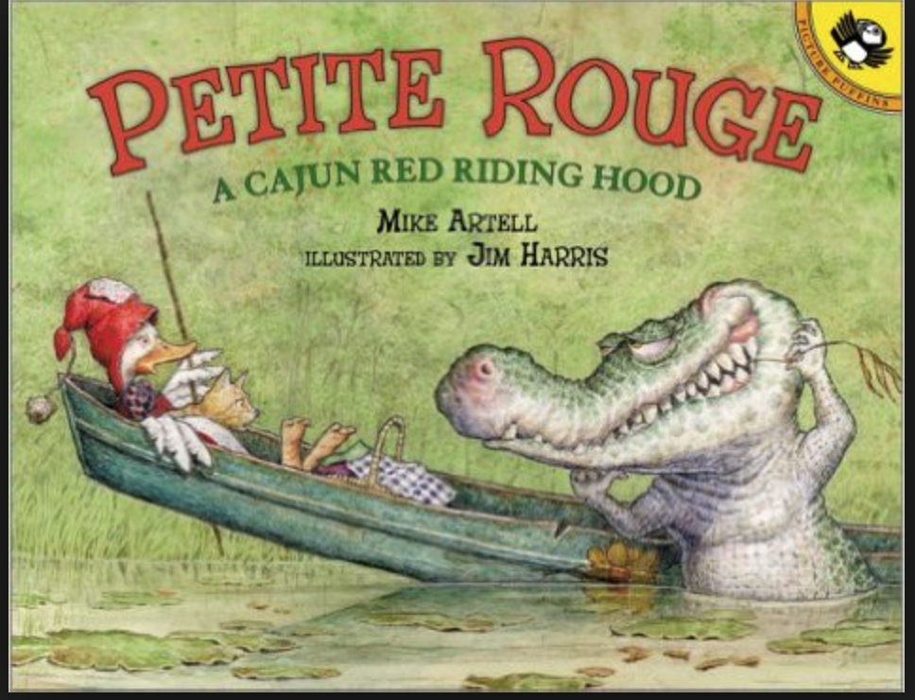
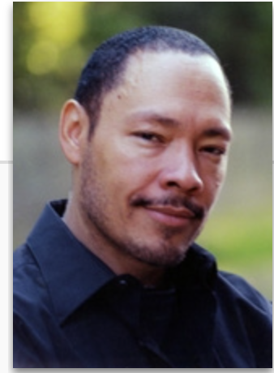
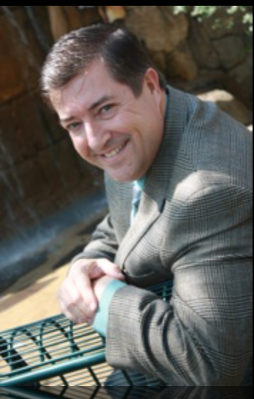
Jerry Palotta
Mike Artell
Floyd Cooper
Michael “Mike” Shoulders

