Slide 1
March 29-March 31, 2017
Hunt Valley Inn, Whyndham Grand
Hunt Valley, MD

Slide 3
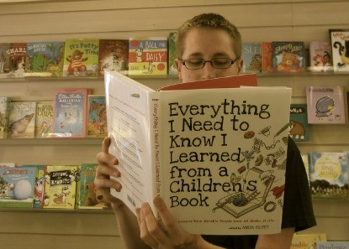
Mr. John Schumacer, a.k.a Mr. Schu
World Renowned Master Librarian
School Library, Classroom Library Expert
Fmr., National Ambassador of School Libraries
Featured Guest Speaker @ Bosses Breakfast, March 29, 2017

Slide 4
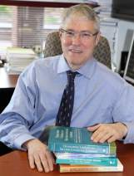
Dr. Tim Shanahan National Everything Literacy Consultant, Author, Speaker, AM Keynote, March 29, 2017

Slide 5
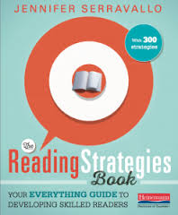
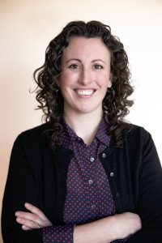
Jennifer Serravallo, PM Keynote, March 29, 2017 National Literacy Consultant, Author, Speaker

Slide 6
Gene Leun Yang, AM Keynote, March 30, 2017
National Book Award for Young People's Literature, Goodreads Choice Awards Best Graphic Novels & Comics
“Reading Without Walls”
— Gene Luen Yang

Slide 7
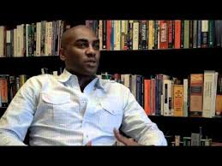
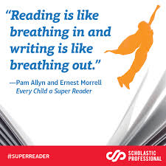
Dr. Ernest Morrell Past President, NCTE Professor, Columbia University, AM Keynote, March 31, 2017
Published author
Expert Research:
*Critical Multiculturalism and The Teaching of Literature *Literature and Popular Culture as Pedagogy
*Critical Media Pedagogy Race and American Schooling
*Transformative School Change

Slide 8
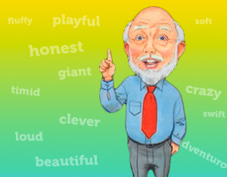
Marvin Terban, PM Keynote, March 31, 2017
Featured author/speaker
“Master of Children’s Wordplay”
ALA Booklist
Award winning author of books on grammar and wordplay
Scholastic author consultant
“Mr. Personality and a Riot”
SoMIRAC

Slide 9
Dr. Amy Hutchison, Assoc. Professor, Literacy and Reading, George Mason University
Published Research:
*Effective technology integration in secondary classrooms
*Teachers’ Perceptions of Integrating Information and Communication Technologies into Literacy Instruction
*Internet use and online reading among middle-grade students at risk of dropping out of school
ILA Presenter and ILA Journal Contributor

Slide 10
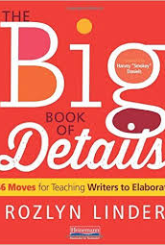
Dr. Rozlyn Linder
Best-Selling Author, Educator, Literacy Expert
Published one of the top-selling books at Heinemann, The Big Book of Details

Slide 11
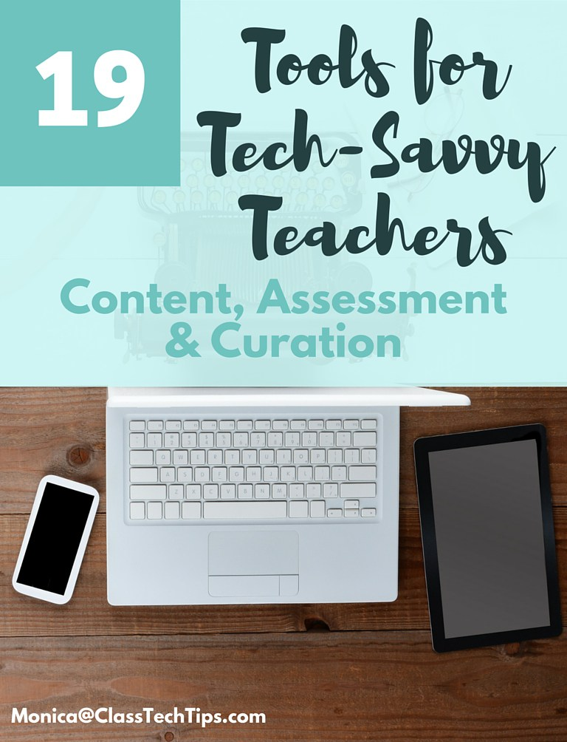
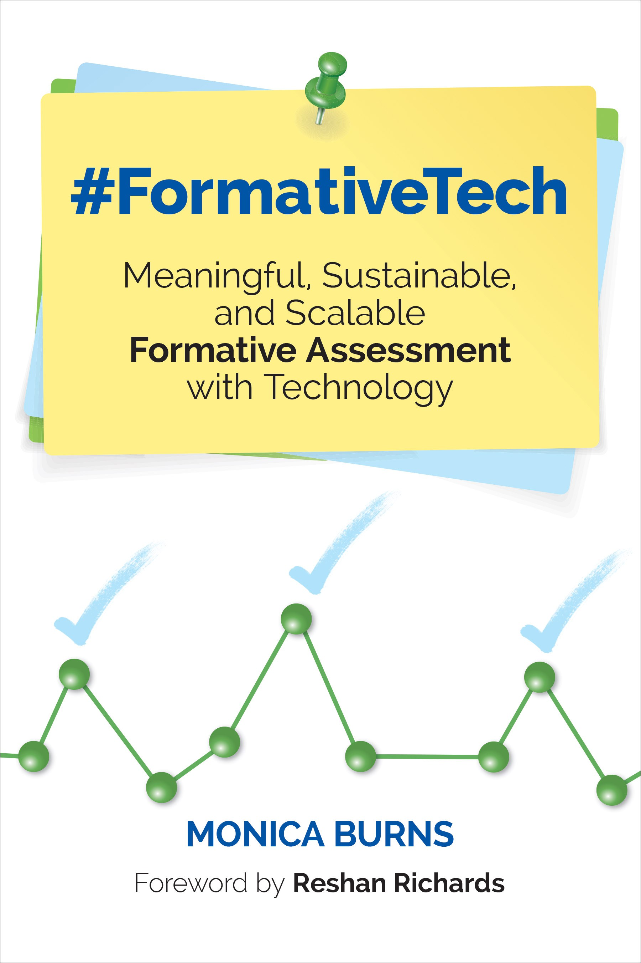
Monica Burns, EdTech Consultant, Educator, Classroom Technology Advocate

Slide 12
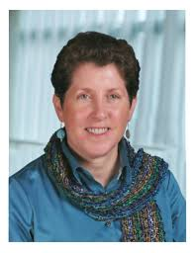
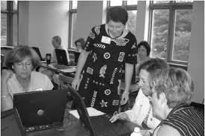
Kathy Schrock, National Educational Technology Expert
Retired award-winning educator, blogger
Considered one of the gurus of educational technology
Expert on literacy in the digital age

Slide 13
Professor Rebecca Wheeler
College Educator
Researcher
ASCD Published Author
Expert in Code-Switching, teaching Standard English in the Urban Classroom, Literacy and Multiculturalism

Slide 14
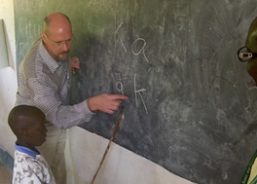
Justin Stygles
English Educator
Vocabulary Expert
Boys and Reading Expert
Author
ILA Journal Contributor
ILA Advisory Committee of Teachers Member
Creator of The Nerdy Book Club and Talks with Teachers Blog Group
Maine Reading Association State Coordinator

Slide 15
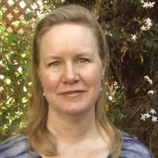
Jennifer Roberts
Published author
English Educator
Expert blogger
Literacy specialist
Google Certified Educator
“Linking literacy and technology for teachers and students…”

Slide 16
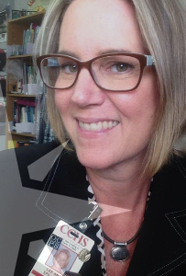
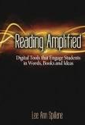
Lee Ann Spillane
High School Educator
Published author
Expert blogger
Reading Literacy specialist, consultant

Slide 17
Literacy Panel Discussion Sessions
Legislative Panel on Literacy Session, Wednesday, March 29, 2017
Literacy and Diversity Panel, Friday, March 31, 2017

Slide 18
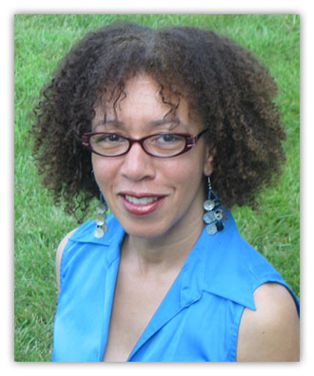
Literacy in Motion: A Night of Flowing Moves, Poetry, Books, and Beats, Wednesday, March 29, 2017 Featuring the Poetry of NY Times Best Selling Author Poet, Carole Boston Weatherford

Slide 19
Authors Galore!
Featured Author Sessions from March 29-March 31, 2017!
Special Event: Authors’ Night 2017—
Theme: Speed Dating With An Author

Slide 20
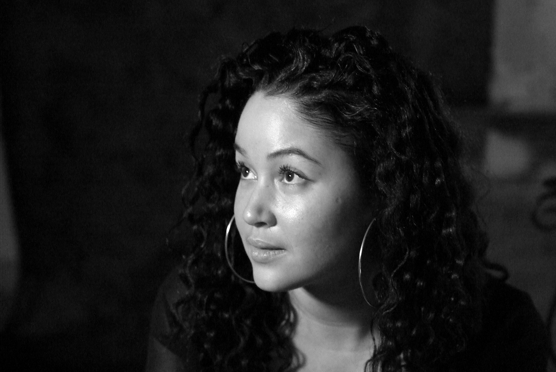
Authors Galore! Brynne Barnes
Acclaimed Author, Poet, Educator
NAACP Image Award Nominee
Featured Author
Featured Guest Author Presenter, Young Authors Awards High School Program, March 29, 2017

Slide 21
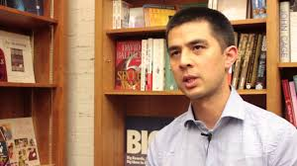
Jason Chin
2016 Maryland Blue Crab Young Readers Award-winning author
Featured author/illustrator

Slide 22
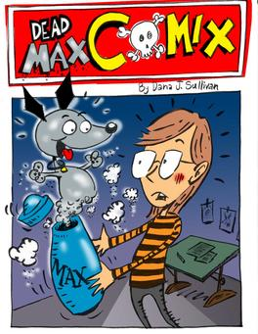
Dana Sullivan—Featured award-winning author/illustrator

Slide 23
Matt de la Pena
Newberry Award-winning author
Featured Guest Author @ Storytellers Breakfast, March 31, 2017

Slide 24
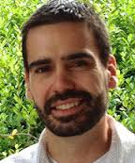
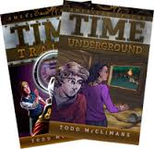
Todd McClimans
Featured Author
Featured Guest Author Presenter, Young Authors Awards Elementary/Middle Program, March 29, 2017
Elementary School Principal

Slide 25
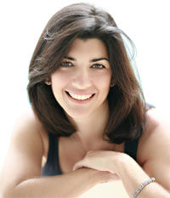
Christina Gonzalez, Featured Author

Slide 26
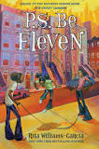
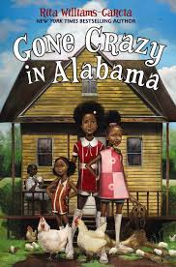
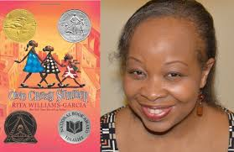
Rita Garcia Williams
Newberry Award-winning author, Coretta Scott King Award winning-author
Featured Guest Author @ Books and Breakfast Event, March 30, 2017

Slide 27
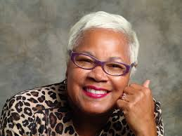
Sharon Flake
Acclaimed Featured Author

Slide 28
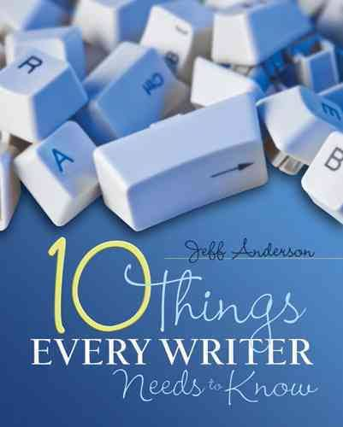
Jeff Anderson—featured speaker and author

Slide 29
Featured Author

Slide 30
And Many More Authors!
Cara Via
Susan Stockdale
Fred Bowen

Slide 32
The 45th Annual SoMIRAC Conference
Visit www.somirac.org for more information
Online registration has started
Join SoMIRAC and get a reduced conference rate
Stay tuned for more updates….
Please join us!

